Slide 1
CSCI 3412 Algorithms Algorithm
Module 1: Course introduction

Slide 2

About Me
About Me
Sung-Hee Nam (Sung, Mr. Sung, Mr. Nam, Professor Nam)
MS in Computer Science from CU Boulder.
30 + years in IBM, AT&T Bell Labs, Lucent, Avaya and some more
6+ years teaching in CU Denver
Logic Design
OOP
Algorithms
Data Structure
Unix Systems Programming
Principle of Programming Languages

Slide 3
About You
About You
Name
Major
# of years and your special interest in Computer Science
Learning objectives and Python experience Survey

Slide 4
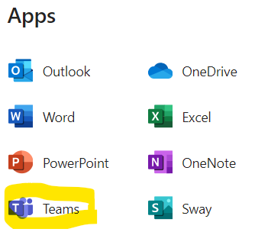
You and I - Communication
You can reach me:
Office: LSC (Lawrence Street Center) bldg. (LW-828)
Initial contact:
Preferred: By Canvas email
Email: sung-hee.nam@ucdenver.edu
Start with “CSCI 3412” in your email subject line
Office Hours:
Mondays (In office): 11:00 – 12:00
Tuesdays (In office): 12:30 - 1:30 pm or
Fridays by appointment only
Only for immediate, short, urgent follow-up response:
MS Teams (Search my name)
Course blackboard: Canvas

Slide 5
Important Documents
Available on Canvas.
Syllabus
Honor Code
In short, violations will NOT be tolerated

Slide 6
About Course

Slide 7
Course Overview and Information
Course Website: Canvas
Going over Syllabus – on Canvas
Course Overview: Fundamental topics of computer algorithms
Prep: Introduction to Python (2 classes)
Algorithm analysis technique – Proof techniques, analysis of asymptotic growth of algorithms
Algorithms for sorting, searching, hashing, string matching, graph
Data structures for efficient algorithms – heaps, hash tables, and (balanced) search trees, skip list
Algorithm design techniques – divide-and-conquer, randomized algorithms, dynamic programming, greedy methods, incremental improvement
Limits of computation – NP completeness
Special topics: Sketch on Quantum computing and algorithm, Blockchain
Learning Objectives – Being more knowledgeable about the existing algorithms, design techniques, analysis of the performance, showing correctness, real-life problem-solving examples.

Slide 8
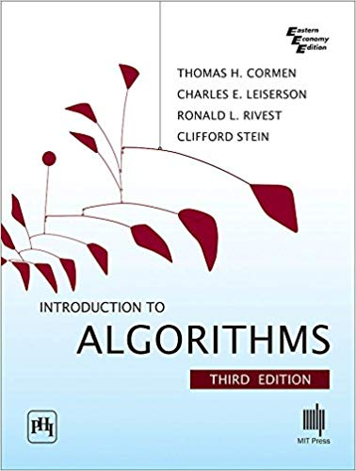
More About Course
Course Pre-Requisites:
CSCI 2312 – Programming topics in the C++ language
CSCI 2421 – Data Structures and Program Design
CSCI 2511 – Discrete Structures
Note: Each student must sign the Prerequisites Agreement from the link below to receive any credit for any assignment or exam
https://ucdenverdata.formstack.com/forms/eng_pre_requisite_agreement_3412
Python will be the programming language used in the class lecture. It is strongly recommended to learn and use Python for the programming assignments.
Required Textbook:
Title: Introduction to Algorithms, Third Edition
Author: CLRS
Course material references including significant portion of lecture slides
CLRS (Cormen, Lelserson, Rivest, Stein) textbook
Wiki sites
Some other supplementary contents from the Internet.
chatGPT

Slide 9
More About Course: Grading
Course Grade: Course grades are a weighted average of the grades earned on all graded material.
Midterm Exam: 20%
Final Exam: 30%
Homework/Programming Assignments: 40%
Participation: 10%
+ Extra credit points
Homework/Programming Assignments:
There will be 7 homework assignments.
Each will include programming assignments as well as several problems from the textbook
Extra credit programming problems
Deepen your knowledge on the topics
Sharpen your Python skill

Slide 10
Yet Another Course Stuff
Attendance: Attendance is important. Review Quizzes 10% of final grade
Late Work Policy:
Any programming assignment not turned in by the due date without prior approval by the instructor based on special circumstances are late.
Any programming assignment not turned in by the due date are late.
Late programming assignments turned in within Four (4) days from the due date will be deducted up to 30%.
No assignment will be accepted past 4 days from the due date without prior arrangement.
Grades of “Incomplete”: The current university policy concerning incomplete grades will be followed in this course.
Email Policy:
I will be using both the University email system and the Canvas email system.
I will respond to your email to the address it was sent from and from the system it was sent from (if you email me from within Canvas, I will respond to Canvas, if you email me from traditional email, I will respond with traditional email).
For class announcements I will send a Canvas group email or post them on the Canvas Announcement
I will be checking my email or Teams message (only for urgent issues) frequently and you can expect a response within 48 hours (weekends and holidays excluded).

Slide 11
Some Fine print …
Other class related information can be found from the class Syllabus which is uploaded in the class Canvas.
Student Expectations
Collaboration and cheating (No Chegg/chatGPT for unethical purpose unless you are allowed to use)
Other University Policies
Engineering school student Honor Code
Violations of the Honor Code
Penalties for violating the Honor Code
TL;DR – no violation will be tolerated

Slide 12

Class success is achieved through synchronized efforts

Slide 13
What is Algorithm?

Slide 14
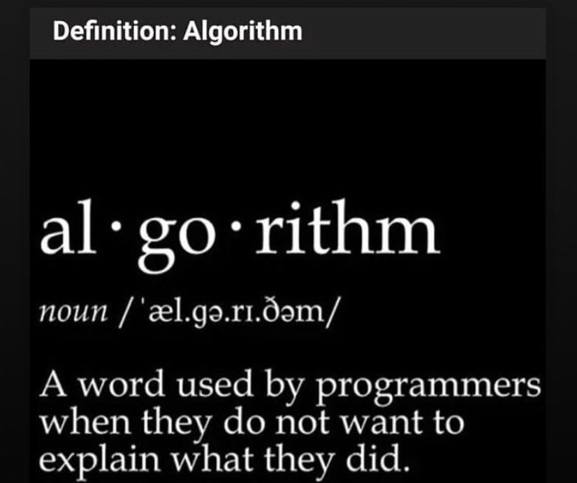
What is Algorithm?
Hmmm… Can’t deny it. I’ve done it …

Slide 15

What is an algorithm?
Wiki: a set of instructions, typically to solve a class of problems or perform a computation; unambiguous specifications for performing calculation, data processing, automated reasoning, and other tasks
Webster Dictionary: a procedure for solving a mathematical problem (as of finding the greatest common divisor) in a finite number of steps that frequently involves repetition of an operation broadly
CLRS Textbook: a sequence of computational steps that transforms the input into the output. Then it continues with saying “a tool for solving well-specified computational problem”
A set of specific and finite steps(instructions) for a computer program to solve a well-defined computational problem or to accomplish a task

Slide 16
So … how about these algorithms?
Task to solve: Put a giraffe into a refrigerator in 3 steps
Task to solve: Then put an elephant into the refrigerator
The Lion King is hosting an animal conference. All the animals attend.... except one. Which animal not?
There is a river you must cross but it is used by crocodiles, and you do not have a boat. How do you manage it to the conference?

Slide 17
Is the first one an algorithm?
An algorithm is correct if for every input instance, it halts with the correct and effective answer contributing to solving given problem.
“Specification must provide a precise and complete description of the computational procedure to be followed.”
Correctness Matters!
Does the 3 steps “giraffe” algorithm solve the problem?

Slide 18

Yet another dad joke …
How many software engineers does it take to change a light bulb?
Well, a group of software engineers came up with an algorithm to change a light bulb:
Hold the light bulb
Plug the light bulb into the socket outlet
Spin yourself counterclockwise until the light bulb tightly screwed into the socket outlet.

Slide 19
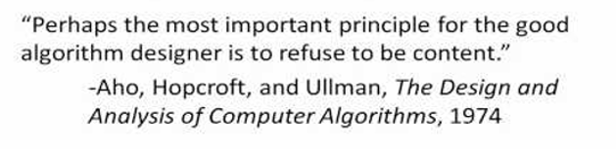
Five Minute University of Algorithms
Father Guido Sarducci's Five Minute University - YouTube
First, is it a correct algorithm?
Next, is it an efficient algorithm?
Efficiency matters!
The mantra of algorithm designer:
Is the algorithm efficient ➔ Can we do better?
If your answer to some problem is 12, you should be ready to answer why 12 is more efficient than 11 and why 13 is not more efficient than 12.

Slide 20
Why We learn Algorithms?

Slide 21
Why algorithm class?
Algorithms are fundamental to other Computer Science subjects
Power of speaking common language and terminology
More efficient software development of existing problems
A good algorithm becomes more and more important and necessary as we get more data, more network interactions (online communications), more complex and bigger size problems to solve.
Will help you get a better job

Slide 22

Grand Canyon: South Rim vs. North Rim
The same Grand Canyon
Two distinctively different views (North vs. South)
South Rim
North Rim

Slide 23
Can we visit both rims in a day?
The average distance across the canyon is only 10 miles
However, the drive between the park's South Rim Village and the North Rim Village is about 212 miles and takes about 4 1/2 hours to drive.
It takes significant time, planning, and effort to visit both rims in one trip.
What should we do?

Slide 24
Two Sides of Learning Algorithms -Focuses for this course -
Two major aspects of learning Algorithms:
Computer Science vs. Mathematics
Practical understanding vs. Formal proof
Tools for solving Real life problem vs. Academically rigorous proof
Breadth vs. Depth
Programming language used : Python vs. C++

Slide 25
Power of Good Algorithms - The Influence of Robust Algorithms -

Slide 26
Arithmetic Sequence Problem
Arithmetic sequence (progression) : a sequence of numbers such that the difference between the consecutive terms is constant.
Ex) 1,2,3,4,5, …. Or 5,7,9,11, 13, 15, …. Or 5,10,15,20,15, …., 225
The n^{th} term of sequence a_{n} = a_{m} + (n-m)d where d is the common difference (step) where a_{m} is the first term.

Slide 27
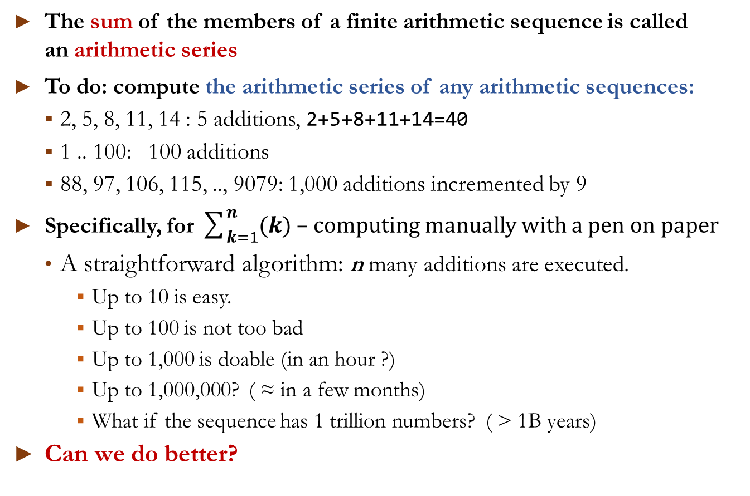
Arithmetic Series: Sum of arithmetic sequence
The sum of the members of a finite arithmetic sequence is called an arithmetic series
To do: compute the arithmetic series of any arithmetic sequences:
2, 5, 8, 11, 14 : 5 additions, 2+5+8+11+14=40
1 .. 100: 100 additions
88, 97, 106, 115, .., 9079: 1,000 additions incremented by 9
Specifically, for $\sum_{k=1}^{n}{(k}$) – computing manually with a pen on paper
A straightforward algorithm: n many additions are executed.
Up to 10 is easy.
Up to 100 is not too bad
Up to 1,000 is doable (in an hour ?)
Up to 1,000,000? ( ≈ in a few months)
What if the sequence has 1 trillion numbers? ( > 1B years)
Can we do better?

Slide 28
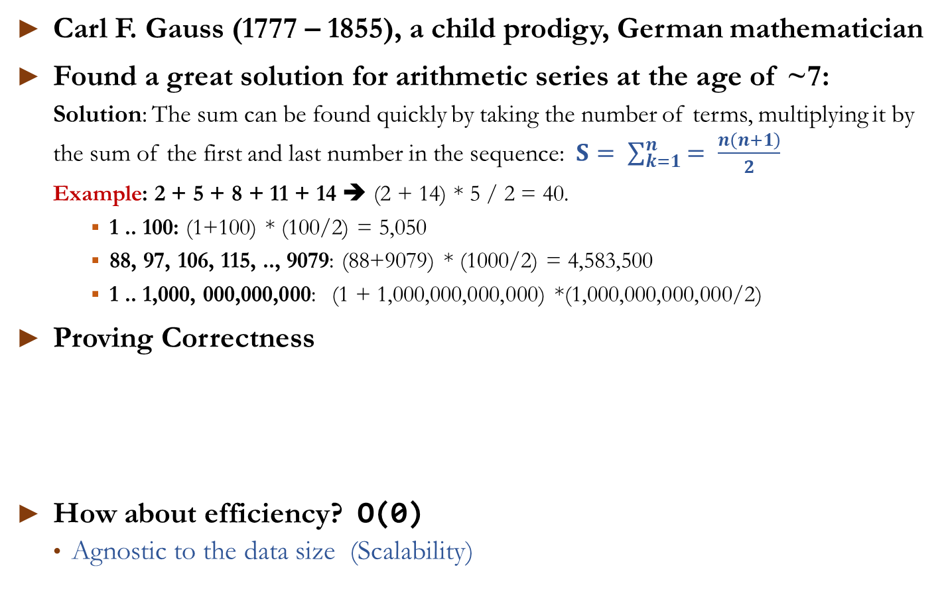

Arithmetic Series – can we do better?, $\sum_{k=1}^{n}{k}$
Carl F. Gauss (1777 – 1855), a child prodigy, German mathematician
Found a great solution for arithmetic series at the age of ~7:
Solution: The sum can be found quickly by taking the number of terms, multiplying it by the sum of the first and last number in the sequence: $S= \sum_{k=1}^{n}{= \frac{n\left(n+1\right)}{2}}$
Example: 2 + 5 + 8 + 11 + 14 ➔ (2 + 14) * 5 / 2 = 40.
1 .. 100: (1+100) * (100/2) = 5,050
88, 97, 106, 115, .., 9079: (88+9079) * (1000/2) = 4,583,500
1 .. 1,000, 000,000,000: (1 + 1,000,000,000,000) *(1,000,000,000,000/2)
Proving Correctness
How about efficiency? O(0)
Agnostic to the data size (Scalability)
2 | + | 5 | + | 8 | + | 11 | + | 14 | = | 40
14 | + | 11 | + | 8 | + | 5 | + | 2 | = | 40
16 | + | 16 | + | 16 | + | 16 | + | 16 | = | 80
➔
80/2 = 40

Slide 29
Problems Solved by Algorithms
General domains:
The Human Genome Project – identifying and databasing 3 billion chemical base pairs making up human DNA
The Internet – search algorithm, packet routing, page ranking, social media friend relationship
Electronic commerce – credit card transactions, banking settlement, public-key cryptography, digital signature, blockchain
Manufacturing and other commercial enterprises – delivery routing, inventory management, crew scheduling
A(G)I
… Almost everything in any computer software

Slide 30
Problems solved by algorithms
Specific examples to be discussed in this course:
Sorting and searching
Shortest path:
choosing the shortest path from all possible delivery routes
Minimum Spanning Tree:
Computer networks, transportation of networks, Handwriting recognition, circuit design, cluster analysis
Dynamic programming - Longest common subsequence:
finding similarity between two DNA sequences
Topological sorting
Finding cycle in a graph (Deadlock problem), Course Scheduling, workflow, data serialization

Slide 31

Interplay between Algorithms & Data Structures

Slide 32
Pitfalls in Quest for Optimal Algorithms
The Dilemma of Choice: With a multitude of candidate solutions, identifying the most efficient algorithm for a given problem is critical.
The Challenge of Selection of efficient algorithm: Among numerous algorithms, finding the optimal one can be challenging:
Sorting algorithm - Wikipedia
For instance, consider sorting a nearly sorted list like “99, 100, 97, 98, 95, 96, … 5, 6, 3, 4, 1, 2”—which algorithm would perform best?
50+ sorting algorithms exist, but for such nearly sorted data, algorithms like less efficient Insertion Sort or Bubble Sort often leads to efficient outcomes due to their adaptive nature.
Beyond Perfection: In many business applications, seeking the "perfect" solution can hinder progress.
Often, approximation algorithms offer a practical balance between the most optimal solution and cost-effective performance
Sometimes, perfect is the enemy of good (betterment)

Slide 33
Algorithms and Data Structures
Data structure: a framework to store and organize data in order to facilitate access and modifications. (CRUD)
Algorithms and Data Structures: Inseparable Pair
Optimal data structures can enhance the efficiency of an algorithm
Different data structures lead to different computational complexities.
Example: Linearly Linked List vs. Binary Search Tree
No one-size-fit-all data structure:
It is important to know the strengths and limitations of them
Avoid the Law of the instrument, otherwise known as the law of the hammer, Maslow's hammer (or gavel), or the golden hammer:
As Abraham Maslow said in 1966:
“I suppose it is tempting, if the only tool you have is a hammer, to treat everything as if it were a nail.”
Understanding the relationship between algorithms and data structures is crucial for designing efficient solutions

Slide 34
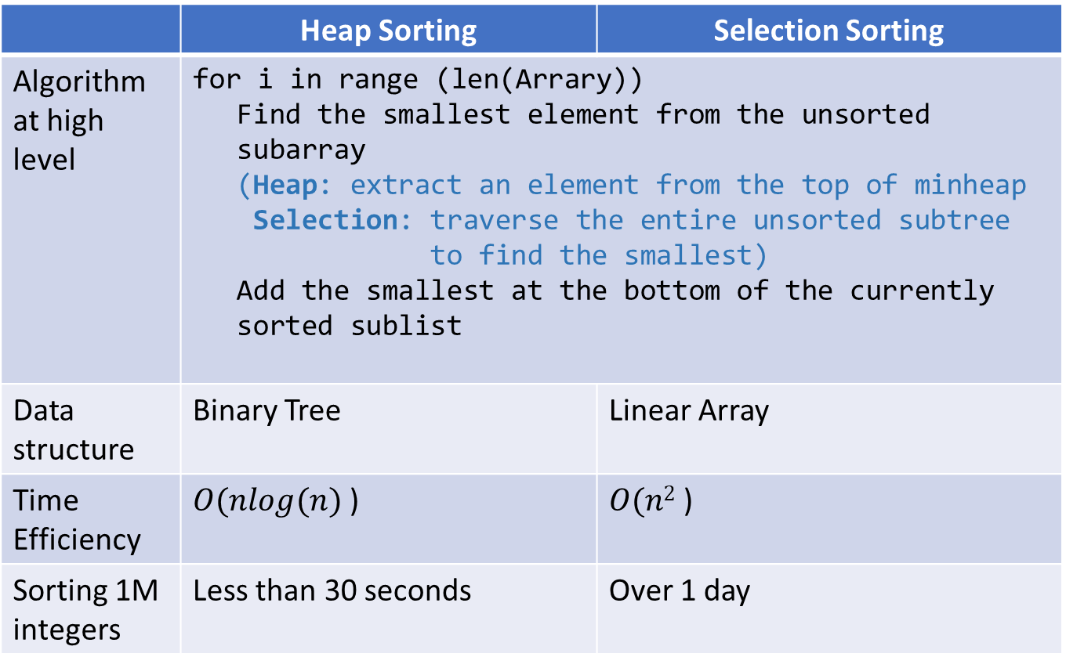
Power of Data Structures: Sorting
 | Heap Sorting | Selection Sorting
Algorithm at high level | for i in range (len(Arrary)) Find the smallest element from the unsorted subarray (Heap: extract an element from the top of minheap Selection: traverse the entire unsorted subtree to find the smallest) Add the smallest at the bottom of the currently sorted sublist
Data structure | Binary Tree | Linear Array
Time Efficiency | $O(nlog(n)$ ) | $O(n2$ )
Sorting 1M integers | Less than 30 seconds | Over 1 day

Slide 35
Hardware Performance And Algorithm Efficiency

Slide 36
Hardware solution: Parallelism, itself may not cut
Single Microprocessor: Physical limitations present a fundamental roadblock to ever-increasing clock speeds (currently 20 atoms apart and 5 atoms are the maximum) – Perhaps no more doubling every year (Moore’s law) – diminishing returns
Multi-processors: To perform more computations per second, chips are being designed to contain not just one but several processing cores
To elicit the best performance from multicore computers, we need to design algorithms with parallelism in mind.
Issues - Too many chefs in the kitchen problem
Synchronization
Avoidance of dead-lock situation
What’s next?

Slide 37
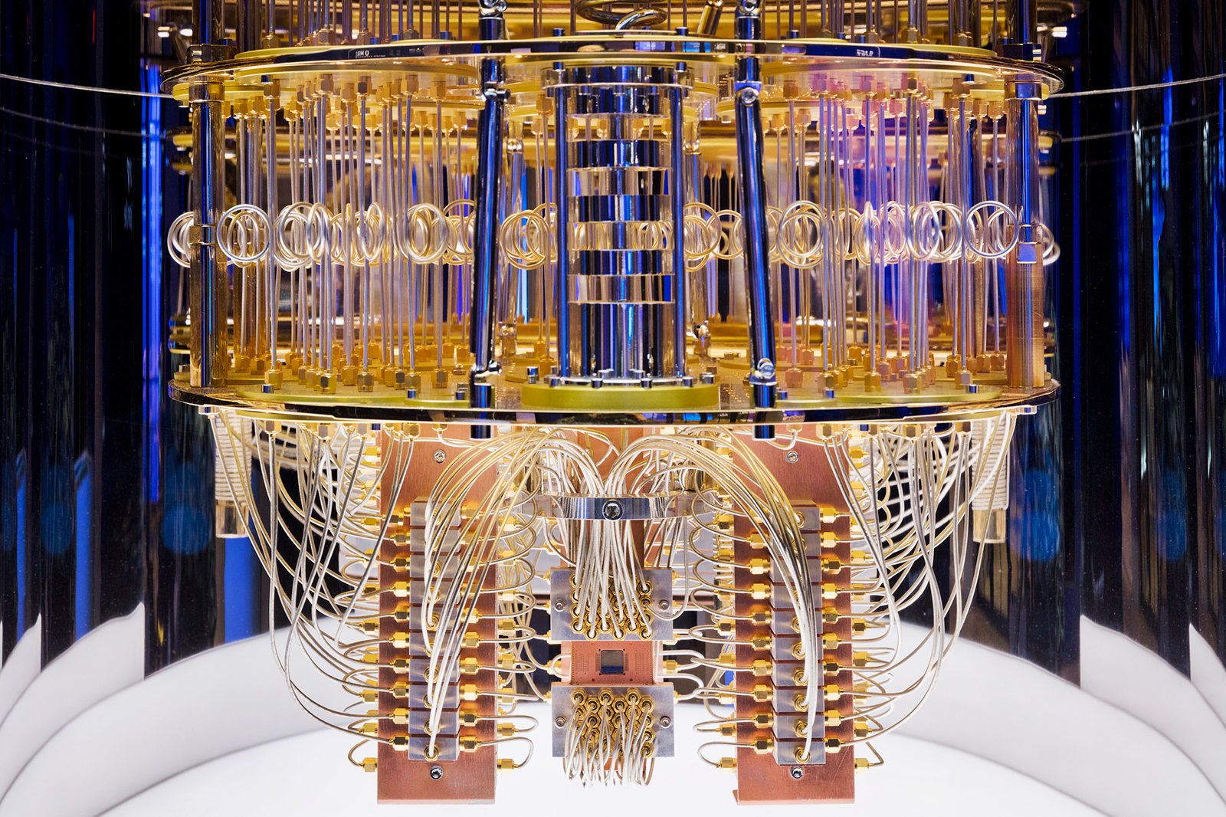
Quantum Computing (in ??? Years)
Beyond binary digital computing – Quantum mechanics
Using quantum superposition and entanglement
May solve very difficult problems that can’t be solved by digital computing systems
qubit: Quantum computing, quantum algorithm, …
… quantum computers are not universally better than classical computers. When people speak about “quantum supremacy”, they really mean that a quantum computer can do a certain task better than classical computers, perhaps one that is impossible to do in any reasonable timeframe with classical computers …
Players: IBM, Google, Microsoft, IonQ, Intel, Honeywell, Amazon, some Chinese Research Centers
Skepticism:
2023 Nature article: current quantum computers as being "For now, [good for] absolutely nothing"
2023 ACM article: insufficient for practical quantum advantage without significant improvements across the software/hardware stack
During a Q&A session at the 2025 Consumer Electronics Show (CES), NVIDIA CEO Jensen Huang expressed that "very useful quantum computers are still a few decades away," estimating their commercial viability to be between 15 to 30 years in the future

Slide 38
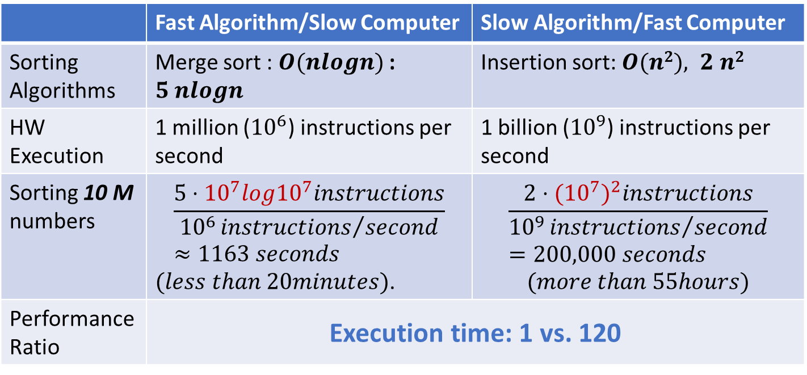
Algorithm Efficiency (Data size matters!!)
Two different algorithms for the same problem: sorting n (10 million numbers)
Two computer models: Faster and slower
 | Fast Algorithm/Slow Computer | Slow Algorithm/Fast Computer
Sorting Algorithms | Merge sort : $O(nlogn)$ : $5 nlogn$ | Insertion sort: $O(n2), 2 n2$
HW Execution | 1 million (${10}^{6}$) instructions per second | 1 billion (${10}^{9}$) instructions per second
Sorting 10 M numbers | $$\frac{5⋅{10}^{7}log{10}^{7}instructions}{{10}^{6}{instructions}/{second}}≈1163 seconds$$ $(less than 20minutes)$. | $$\frac{2⋅{({10}^{7})}^{2}instructions}{{10}^{9}{instructions}/{second}}=200,000 seconds$$ $$(more than 55hours)$$
Performance Ratio | Execution time: 1 vs. 120

